Slide 1
FACE RECOGNITION
Triplet Loss

Slide 2
DataSet
We have a Kaggle which is a great community for datasets and discussion competitions and else so we have got one from it and here is a command for downloading
!kaggle datasets download -d stoicstatic/face-recognition-dataset
In this dataset we have about 1324 folder in each one we have from 2 to 45 image for one person but most one is in range 2 to 4 images
We have about 5524 image for 1216 person for training but our pipeline and data augmentation it make number of training images is not defined
We have 583 images for 108 person for test

Slide 3
Algorithm used
We have used DCNN(deep convolutional nural network) contains about 4.5M parameter (20mb)
We have used MobilNetV3 as our Backbone as it have a small size but high performance as it depends on deeps convolution so computation is very small and can be used on edge devices like mobiles and small computers like Raspberry pi as after using tensor flow lite size will be smaller
And according to FaceNet: A unified Embedding for face Recognition and Clustering we have add another layer according figure 1
For training we have three inputs for our mode which is
Anchor : is an image for person say 1
Positive : is an image for person 1
Negative : is an image for another person say 2
Note all pipeline is clear in notebook

Slide 4
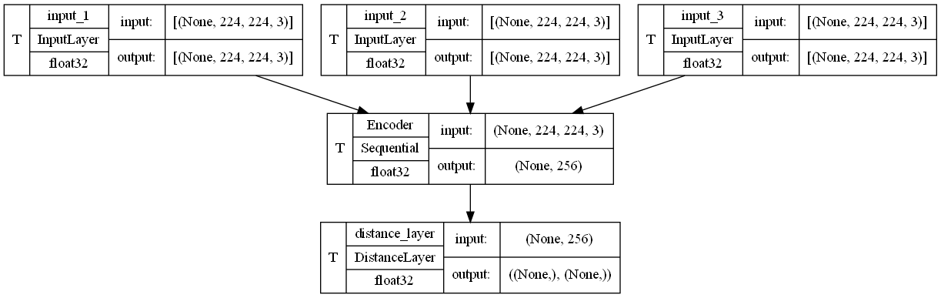
Input for Anchor
Input for Positive
Input for Negative
Embedding Maker
Distance

Slide 5
Encoder
All what encoder do is making embedding for every face which we want distance between embedding of the faces of the same person is about 0 and the distance between two different persons is α which we set equal 1 in our code
Anchor
Positive
Positive
LEARNING
Anchor
Negative
Negative

Slide 6
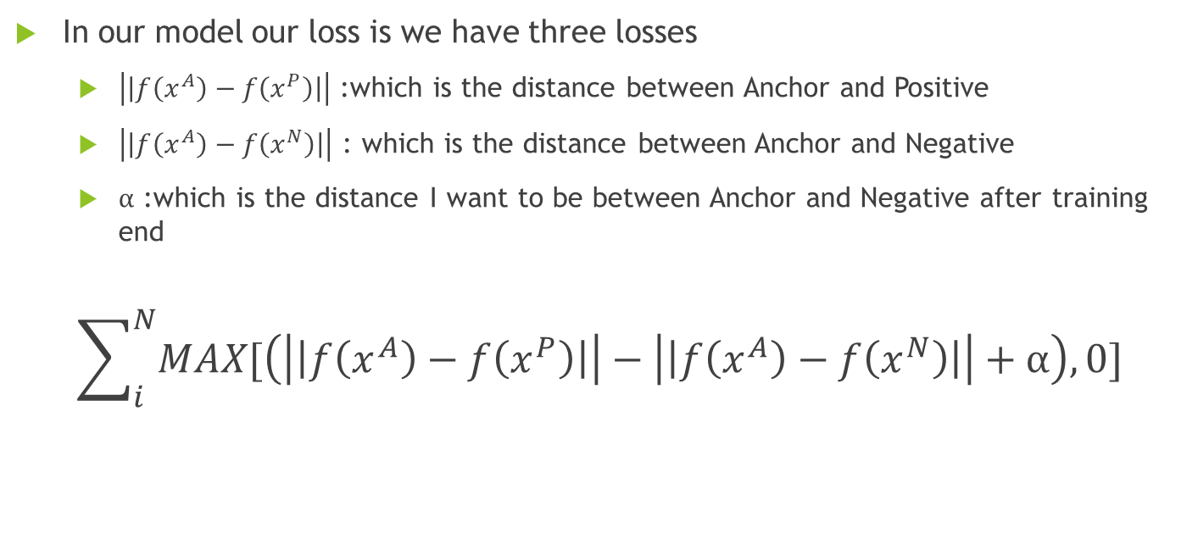
Triplet loss
In our model our loss is we have three losses
$\left|\left|f\left(x^{A}\right)−f\left(x^{P}\right)\right|\right|$ :which is the distance between Anchor and Positive
$\left|\left|f\left(x^{A}\right)−f\left(x^{N}\right)\right|\right|$ : which is the distance between Anchor and Negative
$α$ :which is the distance I want to be between Anchor and Negative after training end
$$\sum_{i}^{N}{MAX[\left(\left|\left|f\left(x^{A}\right)−f\left(x^{P}\right)\right|\right|−\left|\left|f\left(x^{A}\right)−f\left(x^{N}\right)\right|\right|+α\right),0]}$$

Slide 7
Results after training on that model is
We can see over fitting is starting very early so we have to stop

Slide 8
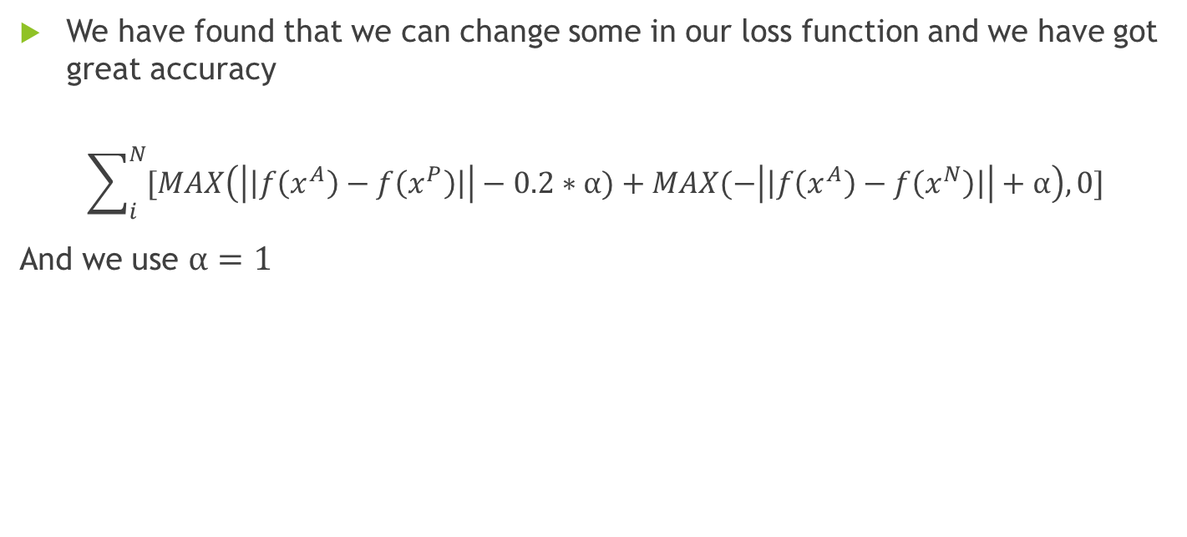
Enhanced Triplet loss
We have found that we can change some in our loss function and we have got great accuracy
$$\sum_{i}^{N}{[MAX\left(\left|\left|f\left(x^{A}\right)−f\left(x^{P}\right)\right|\right|−0.2∗α)+MAX(−\left|\left|f\left(x^{A}\right)−f\left(x^{N}\right)\right|\right|+α\right),0]}$$
And we use $α=1$

Slide 9
Results after training on that model
After continuing using Enhanced Triplet loss we can see over fitting still but very small so the only solution will be more data

Slide 10
Note
This model can capture only about 1000 person to know that is because the l2_normalization nothing else and in my case I don’t want more than 10

